Slide 1
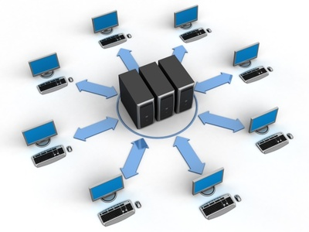
Network Fundamentals
Network models: the osi guidance part 1

Slide 2
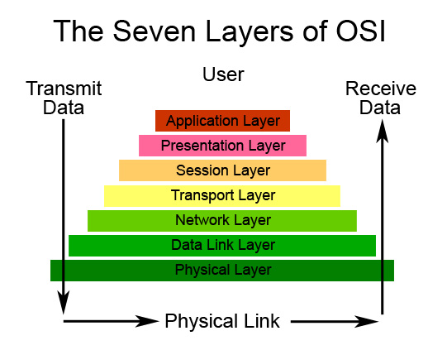
Objectives:
What about network modeling, why do we need them?
The OSI model specifications.
Application layer overview.
Presentation layer overview.
Session layer overview.
Transport layer overview.
Challenging test.

Slide 3
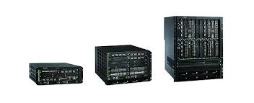
What about network modeling, why do we need them:
In the past, there wasn’t any technical compatibility between network vendors.
A customer was to choose whether to work with CISCO solutions, or IBM solutions, he couldn’t have both.
Network models unifies the technology compatibility issues, all vendors have to have just one perspective of how a network operates.

Slide 4
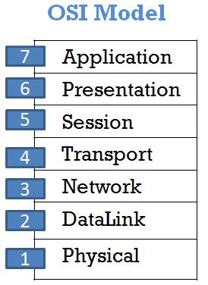
The OSI model specifications:
It consists of hierarchal seven layers.
It helps customers with integrating multiple technical solutions together, instead of restricted by just one vendor solution.
It helps network engineers with network troubleshooting, as it segments the journey for the data between one to device to the other into 7 modes.
It helps Interoperability between Vendors as it allows multi-vendor development.
It prevents change or development in one layer from affecting the other layers.

Slide 5
Application layer overview:
The main function of application layer is to provide the interface for a user to deal with his proper service needed.
It checks the availability of the receiving program, and checks if enough resources exist to establish the communication.
Think if we don’t have an Internet browser, how could we download a web page from a web-server.
HTTP/HTTPs
FTP/TFTP
SNMP
DNS
DHCP
SMTP

Slide 6
Presentation layer overview:
Data Compression
Data Decompression
Data Encryption
Data Decryption
Data Translation

Slide 7
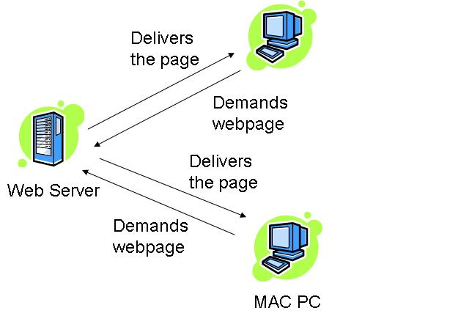
Session layer overview:
A common situation happens when you open multi-web pages on your web browser.
Session layer helps with keeping the data separated when communication happens to be with several peers.

Slide 8
Transport layer overview:
TCP
Stands for transmission control protocol
UDP
Stands for user datagram protocol
Helps with establishing unreliable connections.
Helps with establishing reliable connections.
Protocols that uses TCP: http, FTP and SMTP.
Protocols that uses UDP: TFTP and DNS.

Slide 9
Transport layer overview:
Reliable Connection Mechanisms
Three Way Handshake
Flow Control
Windowing
Notice that none on of reliable connection mechanisms works for the unreliable connection.
UDP communications use connectionless mechanisms where segments are sent without receiving acknowledgments.
Hence It’s known that UDP connection is faster than TCP connection.

Slide 10
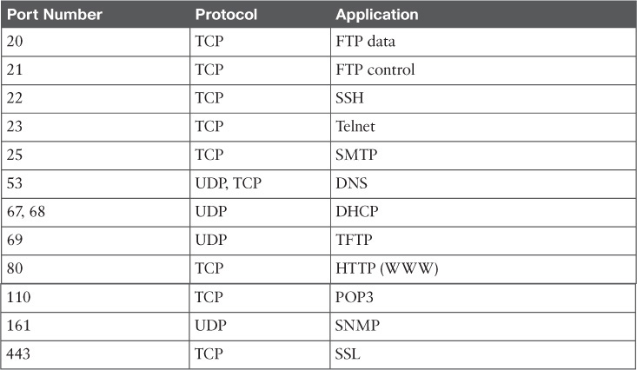
Transport layer overview:

Slide 11
Objectives:
What about network modeling, why do we need them?
The OSI model specifications.
Application layer overview.
Presentation layer overview.
Session layer overview.
Transport layer overview.
Challenging test.

Slide 12
CCNA Routing & Switching
Network models: the osi guidance part 1

